Slide 1
Spatial Filtering
Image Smoothing are two key techniques used in image processing to enhance the quality of an image by reducing noise or improving visual appearance. Both techniques involve manipulating the pixel values of an image based on its surrounding pixels.
1. Spatial Filtering
Spatial filtering is a technique used in image processing where a filter (or kernel) is applied to an image to modify pixel values based on their neighbors. It operates directly on the pixels in the image, meaning it processes each pixel one at a time and applies a mathematical operation to compute the new pixel value from its neighboring pixels.
Types of Spatial Filters:
Linear Filters:
These filters work by computing the weighted sum of the pixel values in the neighborhood. The most common linear filters are averaging filters and Gaussian filters.
Example: A Gaussian filter is commonly used for image smoothing.
Non-Linear Filters:
These filters do not rely on weighted sums but instead use operations like median or maximum values from the neighborhood. These filters are often used for noise removal, especially for salt-and-pepper noise.
Example: A median filter is a non-linear filter commonly used to remove noise.

Slide 2
How Spatial Filters Work:
A spatial filter is usually represented as a kernel (a small matrix, e.g., 3x3, 5x5) that slides over the image.
For each pixel in the image, the kernel is placed over the pixel and its neighbors. The weighted sum of the pixel values in the kernel's area is then calculated and assigned to the central pixel.
This process is repeated for every pixel in the image.
Example: Convolution Operation (Linear Filter)
If you apply a 3x3 averaging filter (a type of linear filter), it would look like this:
[ 1/9 1/9 1/9 ]
[ 1/9 1/9 1/9 ]
[ 1/9 1/9 1/9 ]
Each pixel’s new value is computed by taking the average of itself and its eight neighboring pixels.

Slide 3
In Python, using OpenCV:
import cv2 import numpy as np # Read the image image = cv2.imread('image.jpg') # Apply a 3x3 averaging filter kernel = np.ones((3, 3), np.float32) / 9 filtered_image = cv2.filter2D(image, -1, kernel) # Save or display the result cv2.imwrite('spatial_filtered_image.jpg', filtered_image)

Slide 4
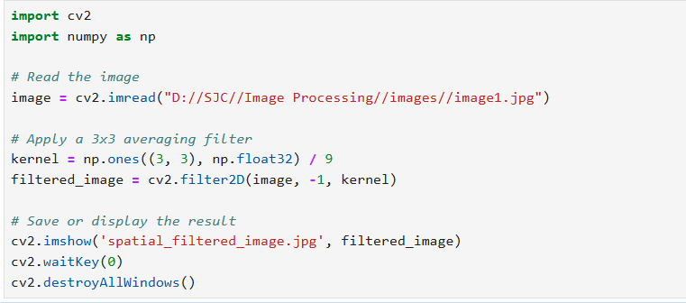

Slide 5

Spatial image

Slide 6
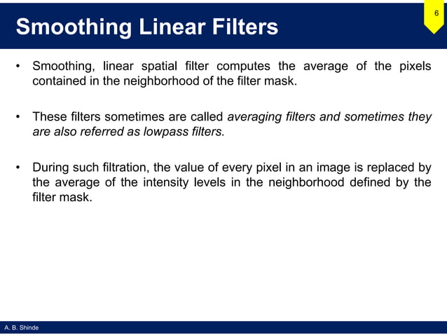

Slide 7
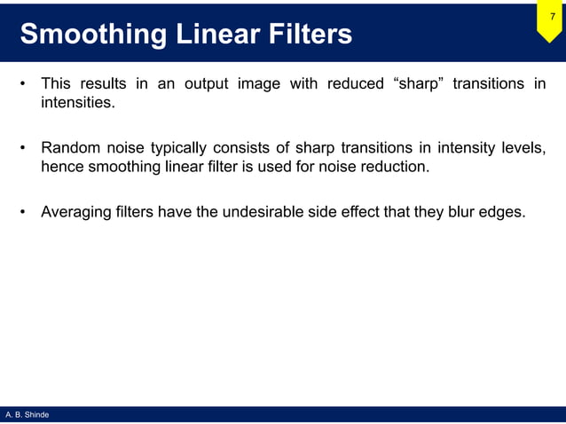

Slide 8
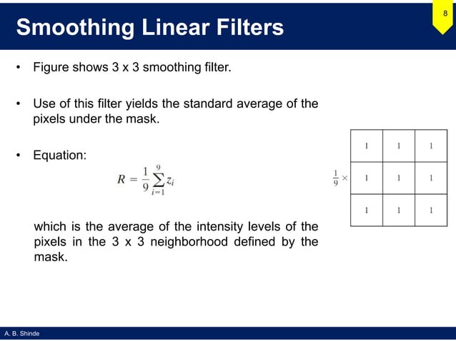

Slide 9
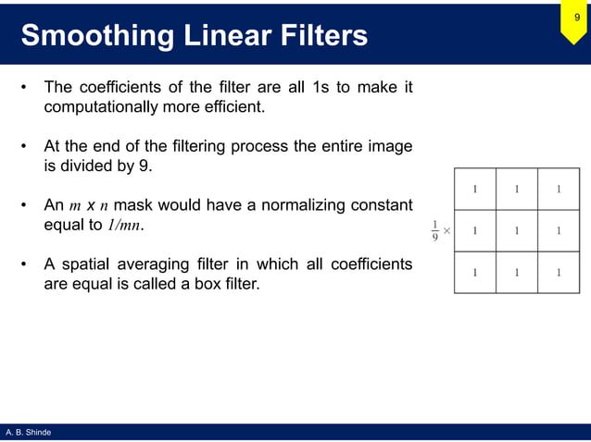

Slide 10
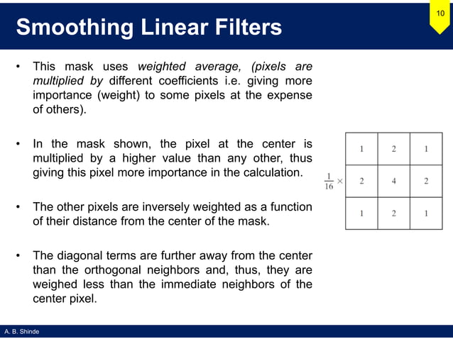

Slide 11
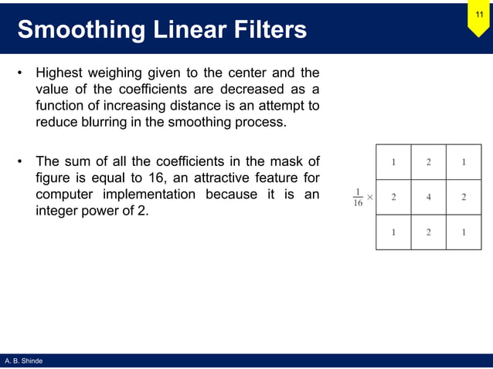

Slide 12
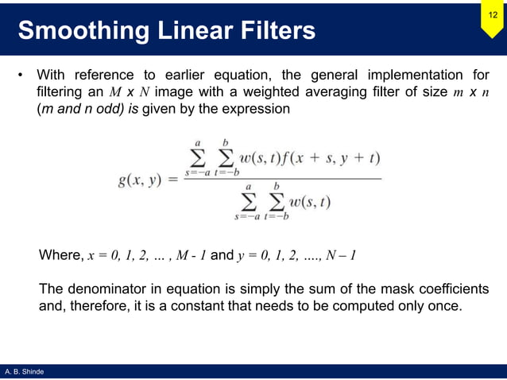

Slide 13
2. Image Smoothing
Image smoothing is a specific type of spatial filtering where the goal is to reduce noise or blurring in an image. This helps to smooth out variations in pixel intensity, which is especially useful for eliminating grainy noise or for visual effect.
Smoothing works by replacing each pixel value with a value derived from its neighboring pixels, and the result is a "softer" or "smoother" version of the original image.
Common Image Smoothing Techniques:
Averaging Filter (Mean Filter):
In this method, each pixel in the image is replaced by the average value of the pixels around it (within a specified window size, such as 3x3, 5x5).
Purpose: Reduces high-frequency noise (but also blurs edges).
Gaussian Blur:
This method uses a Gaussian function to assign weights to the neighboring pixels. The weights are higher for pixels that are closer to the center and lower for those that are farther away. This results in a smoother image with better preservation of edges compared to the mean filter.
Purpose: Softens the image while preserving edge information more effectively than the averaging filter.

Slide 14
Cnt..
Median Filtering:
The pixel value is replaced by the median of the pixel values in its neighborhood. Median filtering is particularly effective at removing salt-and-pepper noise while preserving edges.
Purpose: Excellent for removing impulse noise (like salt-and-pepper noise).
Bilateral Filter:
A non-linear filter that preserves edges while smoothing the regions of uniform color. It does this by considering both the spatial distance between pixels and their color intensity differences.
Purpose: Edge-preserving smoothing. Often used for reducing noise while maintaining sharp boundaries.

Slide 15
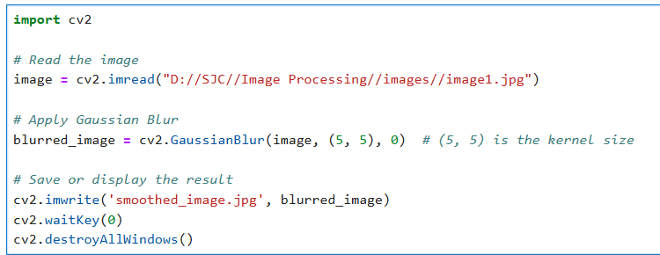

Slide 16

Smoothing

Slide 17
Differences Between Spatial Filtering and Image Smoothing:
Spatial filtering is a broader term that refers to applying any filter (linear or non-linear) to the image. It can be used for various purposes such as noise reduction, edge detection, and image enhancement.
Image smoothing is a specific type of spatial filtering aimed at reducing noise and blurring the image to create a softer look or remove undesirable artifacts.

Slide 18
Common Use Cases for Image Smoothing:
Noise Removal: Smoothing helps reduce various types of noise, such as Gaussian noise or salt-and-pepper noise.
Pre-processing for Edge Detection: Before applying edge detection algorithms (like Sobel or Canny), smoothing the image helps in reducing noise and unwanted artifacts, leading to more accurate results.
Visual Enhancement: In photography or film, smoothing can be used to create a blur effect, soften an image, or give it a more dreamy or artistic look.

Slide 19
Summary of Techniques:
Technique | Purpose | Common Use
Averaging Filter | Smooth out noise by averaging surrounding pixels | Basic smoothing, noise reduction
Gaussian Blur | Apply a weighted average to soften the image | Noise reduction, edge smoothing
Median Filter | Replace pixel with the median of neighbors | Salt-and-pepper noise removal
Bilateral Filter | Preserve edges while smoothing regions | Edge-preserving smoothing

